Slide 1
Course : COMP8031 – IT Services
Period : February 2018
Availability
Session 03
D5664 – Dr. Eng. Antoni Wibowo

Slide 2
AVAILABILITY
  Definition
  Availability is the process of optimizing the readiness of production systems by accurately measuring, analyzing, and reducing outages to those production systems.
  Terms
  UP Time
  Down Time
  Slow Response
  High Availability
  Method to achieve High Availability

Slide 3
UPtime
  UP Time is a measure of the time that individual components within a production system are functionally operating. This contrasts to availability, witch focuses on the system as a whole.
Downtime
  The time when a Configuration Item or IT Service is not Available during its Agreed Service Time. The Availability of an IT Service is often calculated from Agreed Service Time and Downtime. [ITIL v3]
  There are typically two types – Planned Downtime is the time set aside for maintenance activities that can be predicted; unplanned is unexpected events such as failures and prolonged outages.
Bina Nusantara

Slide 4
Slow Response
  Slow response refers to unacceptably long periods of time for an online transaction to complete processing and return result to the user. The period of time deemed unacceptable varies depending on the type of transaction involved.
High Availability
  refers to the design of a production environment such that all single points of failure are removed through redundancy to eliminate production outages. This type of environment is often referred to as being fault tolerant
Bina Nusantara

Slide 5
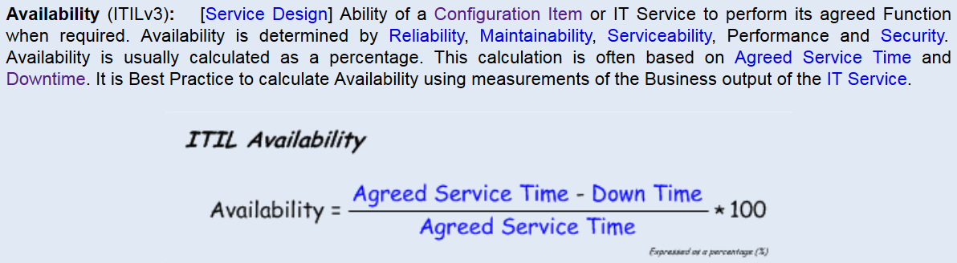
Bina Nusantara

Slide 6
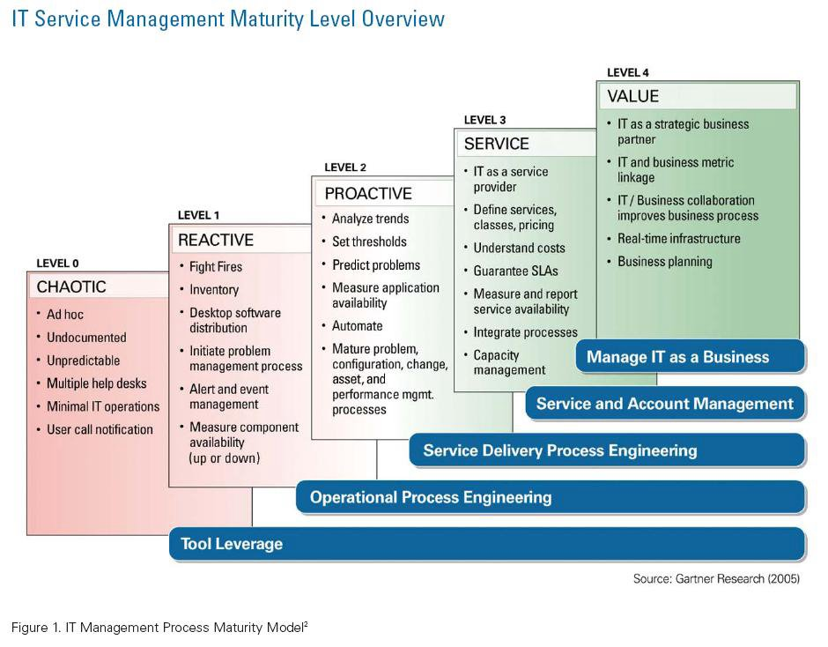
Register to take the 20-question assessment.
Based on your answers, you will receive results and valuable tips on how to improve.
http://www.teamquest.com/resources/maturity_assessment
Bina Nusantara

Slide 7
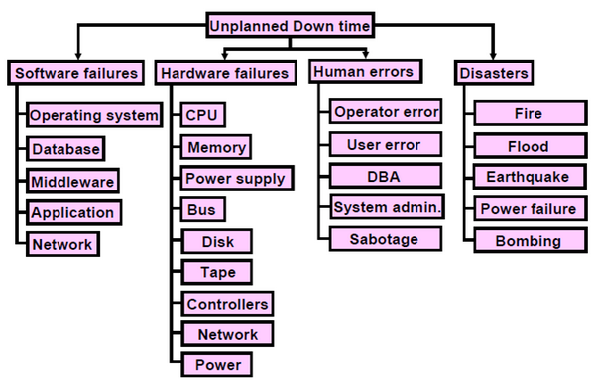
Bina Nusantara

Slide 8
Planned downtime for maintenance operations should be negotiated with customers and all attempts will be made to localize these times to regularly scheduled periods of low business activity.
Bina Nusantara

Slide 9
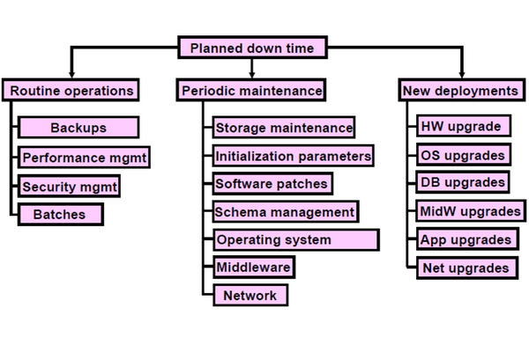
Bina Nusantara

Slide 10
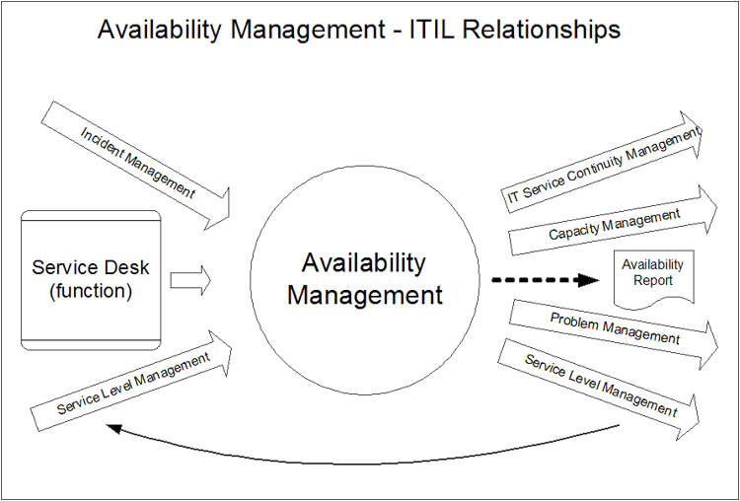
Availability management has two primary inputs: Service level and Incident Management.
Bina Nusantara

Slide 11
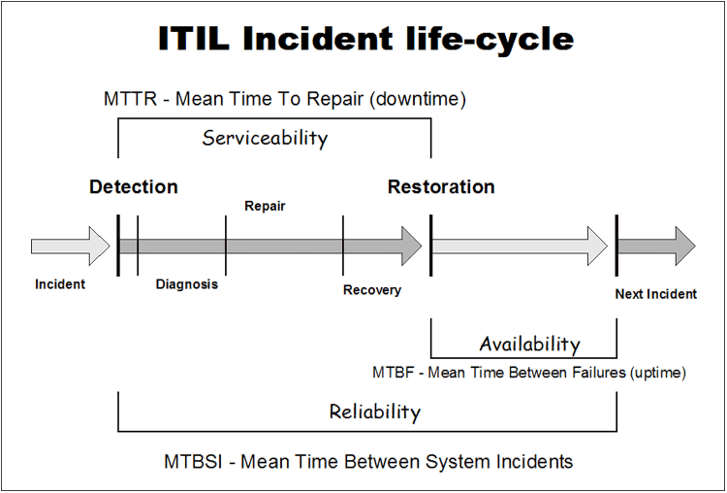
Bina Nusantara

Slide 12
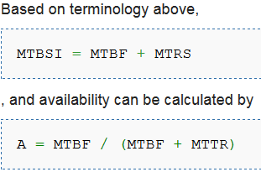
Some availability measurements, that may be included in SLA:
  Mean-Time-Between-Failure (MTBF): elapsed time between a service gets up and down.
  Mean-Time-To-Repair (MTTR): elapsed time to repair a configuration item or IT service.
  Mean-Time-Between-System-Incidents (MTBSI): elapes time between detection of two consecutive incidents.
  Mean-Time-To-Restore-Service (MTRS): elapes time from the detection of an incident until it gets up.
Bina Nusantara

Slide 13
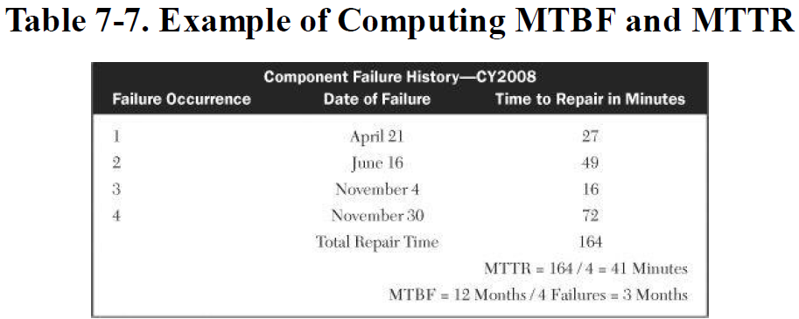
Bina Nusantara

Slide 14
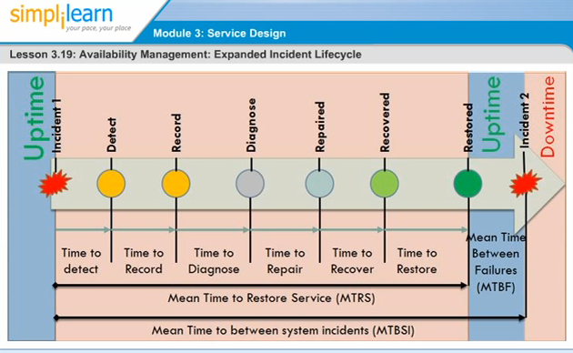
https://www.youtube.com/watch?v=4mbHYlgFUvE
Bina Nusantara

Slide 15
The metrics are:
  How long it takes to detect an incident
  Total downtime per service (application/ customer)
  How long it takes to recover from in incident
  The availability of the services
  How frequently incidents occur
  The improvement in availability of the IT service
Bina Nusantara

Slide 16
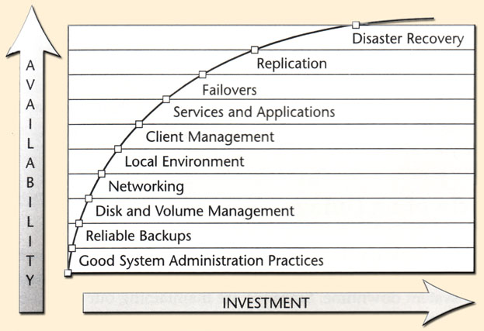
Evan and Stern's Availability Index
Bina Nusantara

Slide 17
The 10 major areas in increasing overall availability
Good System Administrative Practices - these practices lay the foundation for all the technologies that can get added to provide better availability. Some are easy to implement while others are hard.
Backups and Restores - Backups represent the last line of defence against data loss. You should regularly test your ability to restore and ensure that backups are not, themselves a single point of failure - make two copies of critical backups
Disk and Volume Management - Disks are a frequent point of failure. Therefore, removing them as a single point of failure (through mirroring) and ensuring the ability to quickly replace a bad disk (how swapping) arew important first and relatively inexpensive ways to achieve higher availability. In addition technological approach such as SAN, NAS and virtualization are other important methods of ensuring disk availability
Bina Nusantara

Slide 18
The 10 major areas in increasing overall availability
Networking - networking computers has increased the overall complexity and number of potential failure nodes. Networks experience periods of peak loads which are sometimes unpredictable. problems are often difficult to track down. They are also highly sensitive to denial of service attacks
The environment in which critical systems operate - Data centres require specific operating characteristics to minimize risk and maximize server and application availability and performance
Managing clients - there are two types of clients- those residing on the internal network and mobile clients. The latter presents enhanced difficulty in eliminating client disks as a single point of failure for business-critical data and re-creating client systems in the event of failure or a request for a replacement.
Bina Nusantara

Slide 19
The 10 major areas in increasing overall availability
Application Level Recovery Methods - Applications should deal with failures in a way which minimizes the overall effect on the business. The design of the application as well as the robustness of the application software will determine how well the system will tolerate minor failures without overly lengthy outages
Clustering Techniques - methods to ensure the availability of a second (or more) system in the event that a primary system fails. The standby server quickly takes over the entire load of the system (ie. failover).
Replication Techniques - the copying of data from one disk to another, completely independent system resulting in two equally consistent and viable data sets.
Disaster recovery - the ability to recreate the environment exactly within a specified time-frame following a failure which carries with it a risk or high possibility of not being recoverable within a specified timeframe (usually days or longer).
Bina Nusantara

Slide 20
UP TIME
UP Time is a measure of the time that individual components within a production system are functionally operating. This contrasts to availability, witch focuses on the system as a whole.
  Component:
      Data center facility
      Server hardware ( processor, memory, channels)
      Server system software (operating systems, program products)
      Application software (program, database management)
      Disk hardware (controllers, arrays, disk volumes)
      Database software (data files, control files)
      Network software
      Network hardware (controllers, switches, lines, hubs, router, reapiter, modem
      Desktop software (OS, program products, application)
      Desktop Hardware (processor, memory, disk, interface card)
Bina Nusantara

Slide 21
SLOW RESPONSE
Factor contribute to slow response time:
      Growth of a database
      Traffic on the network
      Contention for disk volume
      Disabling of processors or potions of main memory in servers
Definition:
  Slow response refers to unacceptably long periods of time for an online transaction to complete processing and return result to the user. The period of time deemed unacceptable varies depending on the type of transaction involved.
Bina Nusantara

Slide 22
Downtime
Definition:
  Downtime refers to the total inoperability of a hardware device, a software routine, or some other critical component of a system that results in the outage of a production application.
Perbedaan slowresponse dan downtime
  Slow response berhubungan dengan performance, tunning, pengaruh/ketergantungan personil, dan proses.
  Down time adalalah sangat berhubungan dengan availability, karena peralatan/komponen/software berhenti melakukan proses produksi.
Bina Nusantara

Slide 23
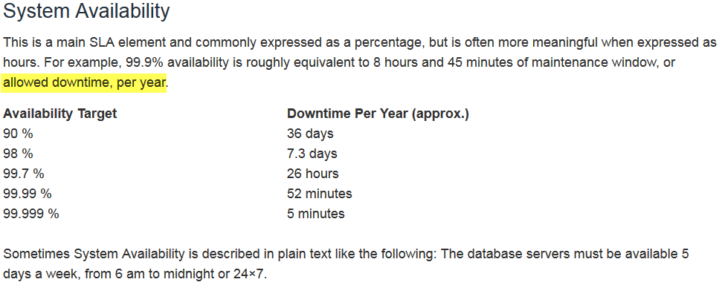
Bina Nusantara

Slide 24
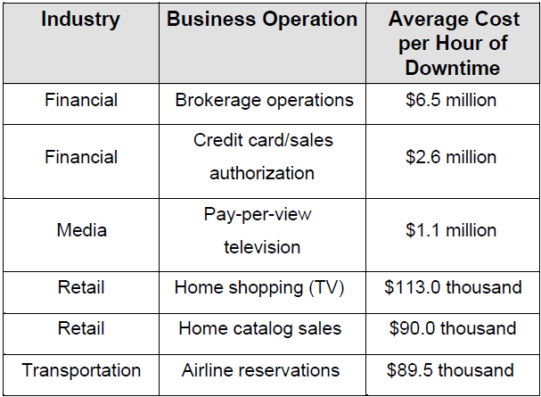
Improving Systems Availability
http://www.dis.uniroma1.it/irl/docs/availabilitytutorial.pdf
Bina Nusantara

Slide 25
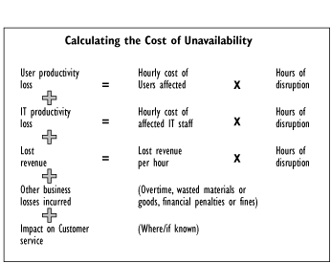
Bina Nusantara

Slide 26
High Availability
High availability refers to the design of a production environment such that all single points of failure are removed through redundancy to eliminate production outages. This type of environment is often referred to as being fault tolerant
    Fault Tolerant refers to production environment in which all hardware and software components are duplicated such that they can automatically failover to their backup component in the event of a fault.
Factor utk mendapatkan ultimate high availability:
  Budget limitations, Component failuters, Faulty code, Human error, Flawed design, Natural disasters, Unforeseen business shifts.
Bina Nusantara

Slide 27
7 hal untuk High Availability
Redundancy
Reputation
Reliability
Repairabillity
Recoverability
Responsiveness
Robustness
http://www.informit.com/articles/article.aspx?p=175932&seqNum=91
Bina Nusantara

Slide 28
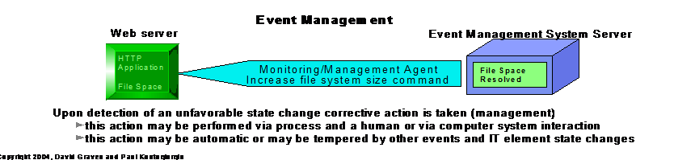
EVENT MANAGEMENT
Bina Nusantara

Slide 29
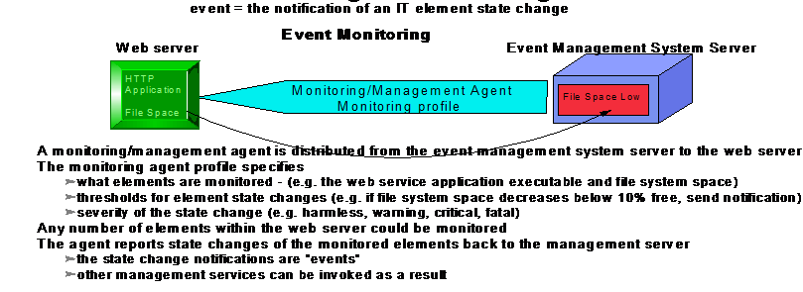
EVENT MONITORING
Bina Nusantara

Slide 30
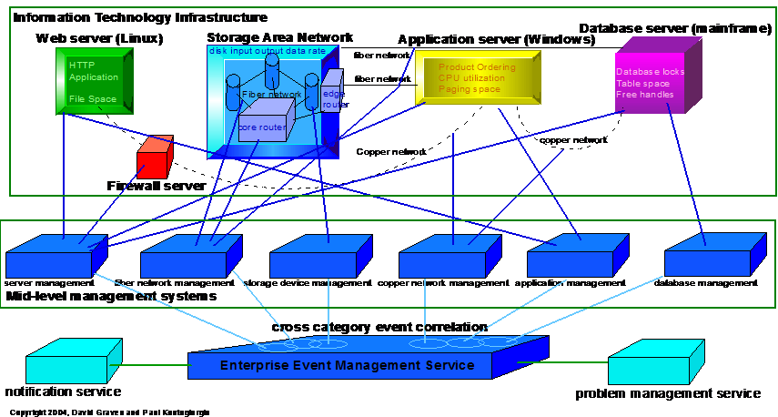
Event Enterprise Management
EEM= 3 dimensional management of IT Element:
  1. across IT element category
  2. across processing platform management
  3. interconnection of management services
Bina Nusantara

Slide 31
Event & Fault Management
(Introduction of terms and concepts)
Monitored Element
Threshold
Monitoring Rate
Response Level
Action
    Monitoring Server
    Monitoring Agent
    Event Mgmt Server
    Event Mgmt Console (clients)
    Peripheral Servers (Notification, Escalation, Problem Mgmt, etc)
Bina Nusantara

Slide 32


Event Processing
Report
Presentation
Report Prep DB
Problem/Change
w/Notification
Configuration Mgmt
Event Mgmt
Disparate Data
Multi Platform Monitoring, notification and Management
Network
Server
Apps
DBs
Storage
Bina Nusantara

Slide 33
Service interconnections
Possible service interconnections in Infrastructure Management
  Operations
  Security
  Software distribution
  Availability
  Performance and Capacity
  Inventory
  Backup and Recovery
  Business Process Management
  Provisioning (Utility Computing)
Bina Nusantara

Slide 34
Service Interconnection
Possible service interconnections in IT Service or Relationship Management
  Reporting
  Problem
  Notification & Escalation
  Change
  Asset
  SLA (Service Level Agreement)
Enterprise event management tool sampling (contoh)
  HP IT Operator
  Computer Associates TNG Unicenter The Next Generation
  BMC Suite by BMC Software
  Tivoli Enterprise Console
  Netview for z/OS
  Dell OpenManage
  IBM Director
Bina Nusantara

Slide 35
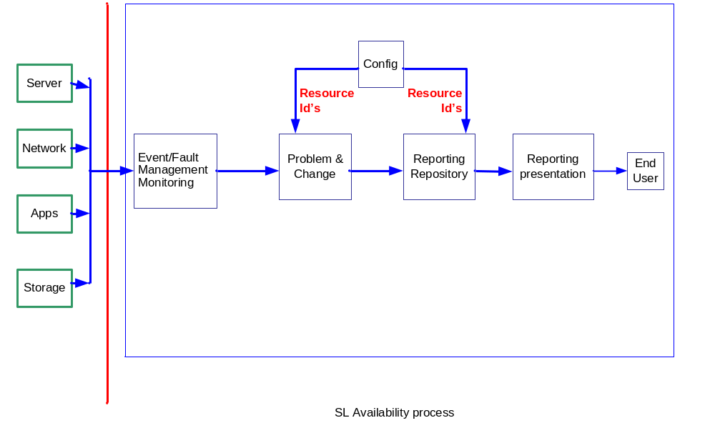
SLA PROCESS
Bina Nusantara

